Slide 1
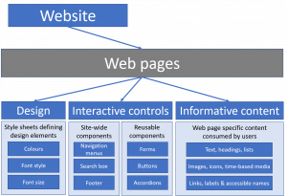
Thato Ntsimane Website presentation

Slide 2
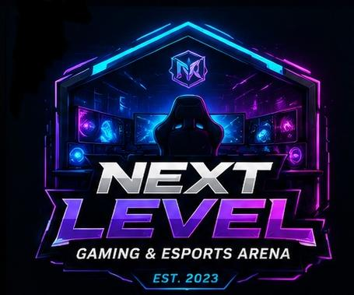
Next level Gaming & Esports arena Logo that was chosen by the team

Slide 3
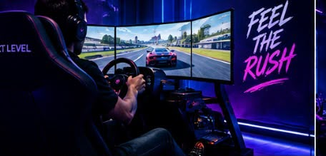
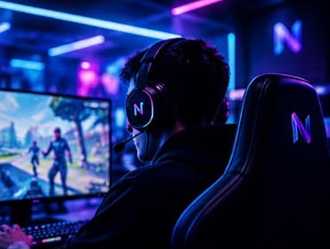
Next Level gaming & sports website is about gamers that can enter and see modern entertainment venues for all ages. Gamers can come and enjoy. Created for Jason Naidoo because he noticed that many lack access to high performance gaming equipment so you can access such through the website see different packages, locations and business operation times. ALWAYS REMEMBER TO HAVE FUN

Slide 4
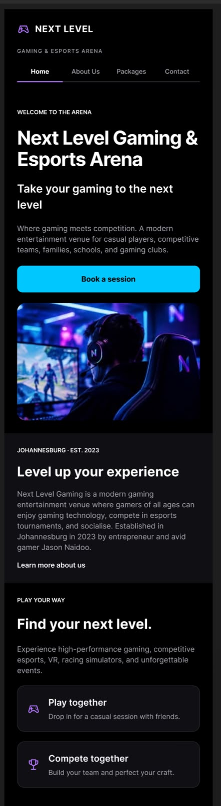
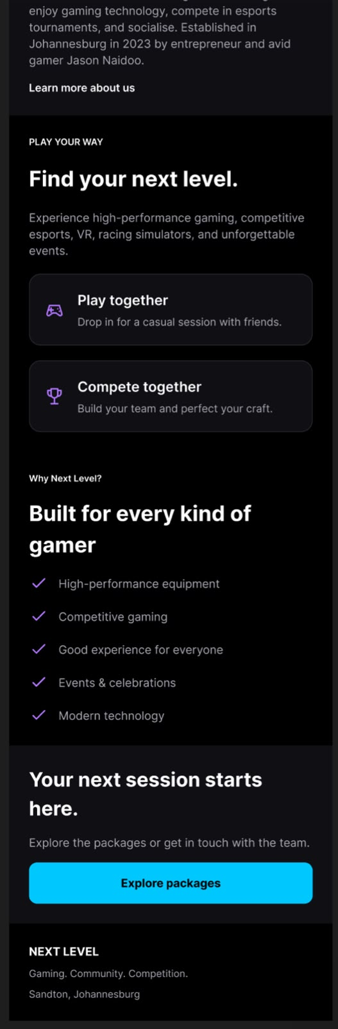
HOME PAGE

Slide 5
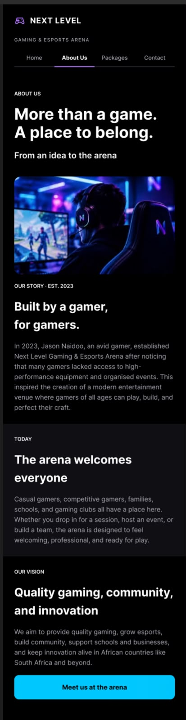
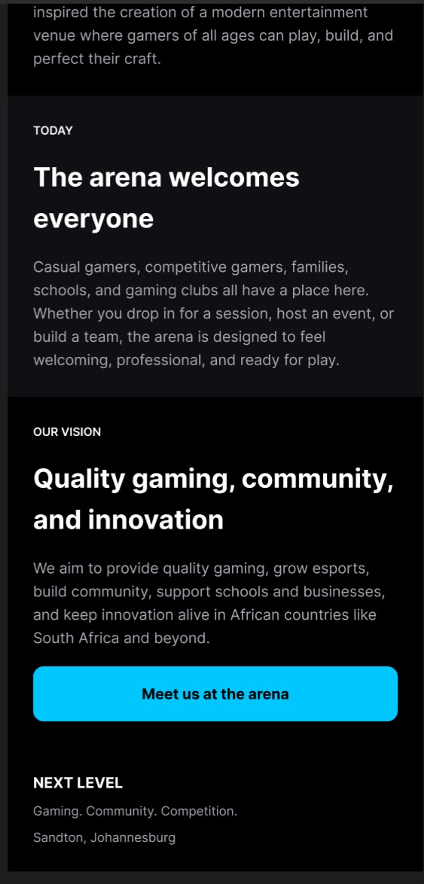
ABOUT US

Slide 6
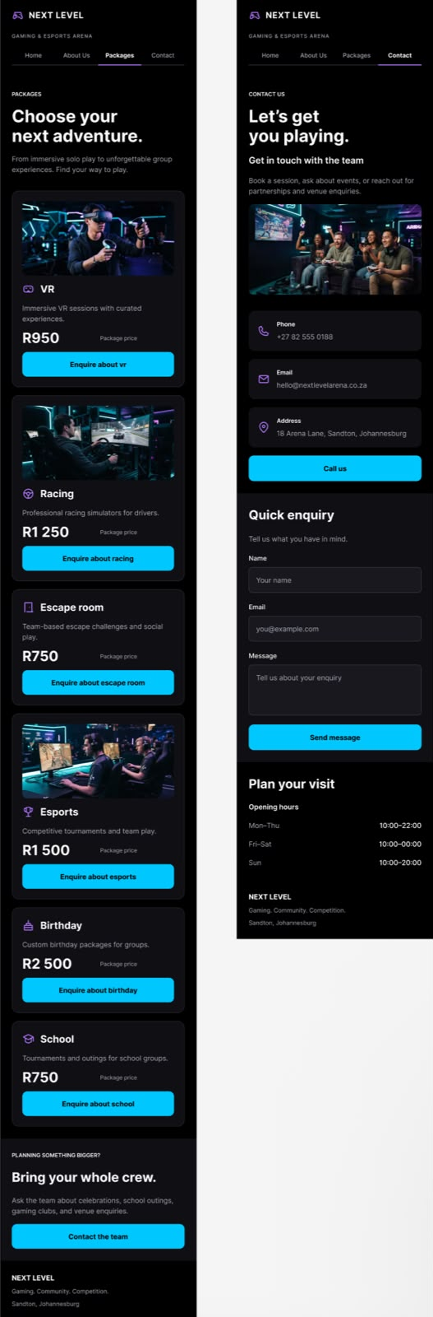
PACKEGES AND CONTACT INFO

